Slide 1
Object orientation
- The Core of OO programming
Sanjeevi R
Sanjeevi_nightwing@yahoo.com

Slide 2
Introduction
How programming came into being
2 Major programming paradigms
Functional programming
These are very mathematically oriented and have the notions of functions as the building blocks of computation.
Imperative / Procedural programming
These have variables(state) and procedures as the main building blocks. Such languages are well known—eg. C—and include what we call object oriented languages such as C++ and Java.

Slide 3
The hardware behind programming
Computers have 2 memories [in programming interest] –
system memory/ram
Registers
really fast, but small chunks of memory. These are built into the CPU itself.
The CPU acts only on the chunks in the registers so the computer is constantly loading chunks of data from system memory into registers and operating on the register values.
Each of the registers is a small, fixed size. On today’s machines, they are usually just 32 or 64 bits.

Slide 4
The hardware behind programming – Contd.
If I have two lots of 128-bits of data, how do I add them together on a 32 bit machine? I can’t squeeze 128 bits into 32bits. I have to chop the 128 bits up into 32 bit chunks, add corresponding chunks together and then put those new chunks back together again to get a 128-bit answer. Can you imagine having to do this every time you needed to do an addition? Nasty.
The Solution - We program in high level code and leave it to the compiler to figure out that when we say c= a+b; we actually mean “chop up a and b, load them into registers, add them, look out for overflow, then put all the pieces back together in memory somewhere called c”.

Slide 5
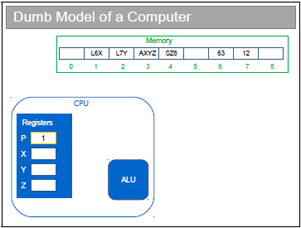
How programs are executed

Slide 6
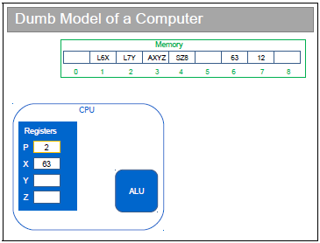
How programs are executed

Slide 7

How programs are executed

Slide 8

How programs are executed

Slide 9
The hardware behind programming – Contd.
processor instruction sets are different processors like Intel and AMD processors.
The result? Any set of instructions for one processor only works on another processor if they happen to use the same instruction set. i.e. The binary executable produced by the compiler is CPU specific.
The Answer – Compilation
Low level vs Medium level Vs High level languages

Slide 10
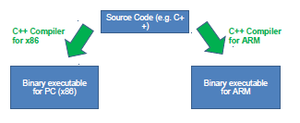
Compilation

Slide 11
Enter java
Sun Microcomputers came up with a different solution
They conceived of a Virtual Machine – a sort of idealised computer.
You compile Java source code into a set of instructions for this Virtual Machine (“bytecode”)
Your real computer runs a program (the “Virtual machine” or VM) that can efficiently translate from bytecode to local machine code.
Java is also a Platform
So, for example, creating a window is the same on any platform
The VM makes sure that a Java window looks the same on a Windows machine as a Linux machine.
This is sold as “Write Once, Run Anywhere”

Slide 12
The jvm
This is a piece of software that has been compiled specifically for your architecture (like most off-the-shelf software) and which acts an interpreter, converting bytecode instructions into meaningful instructions for your local CPU.
All the CPU-specific code goes into the virtual machine, which you should just think of as a piece of intermediary software that translates commands so the local hardware can understand.
Ultimately it is the platform specific JVM that makes the java code platform independent by translating the compiled source code into machine specific instructions.

Slide 13
Java Environment setup
What is JDK?
What is JRE?
Download and install JDK.
Set environment variable.
JAVA IDEs.

Slide 14
Code – Very simple java program
public class MyFirstJavaProgram
{
/*
* This is my first java program.
* This will print 'Hello World' as the output
*/
public static void main(String []args)
{
System.out.println("Hello World"); // prints Hello World
}
}

Slide 15
Run the code
Let's look at how to save the file, compile and run the program. Follow the steps given below:
Open notepad and add the code as above.
Save the file as: MyFirstJavaProgram.java.
Open a command prompt window and go to the directory where you saved the class. Assume it's C:\.
Type ' javac MyFirstJavaProgram.java ' and press enter to compile your code. If there are no errors in your code, the command prompt will take you to the next line (Assumption : The path variable is set).
Now, type ' java MyFirstJavaProgram ' to run your program.
You will be able to see ' Hello World ' printed on the window.

Slide 16
Basic syntax
About Java programs, it is very important to keep in mind the following points.
Case Sensitivity - Java is case sensitive, which means identifier Hello and hello would have different meaning in Java.
Class Names - For all class names the first letter should be in Upper Case. If several words are used to form a name of the class, each inner word's first letter should be in Upper Case. Example class MyFirstJavaClass
Method Names - All method names should start with a Lower Case letter. If several words are used to form the name of the method, then each inner word's first letter should be in Upper Case. Example public void myMethodName()

Slide 17
Basic syntax
Program File Name - Name of the program file should exactly match the class name. When saving the file, you should save it using the class name (Remember Java is case sensitive) and append '.java' to the end of the name (if the file name and the class name do not match your program will not compile). Example : Assume 'MyFirstJavaProgram' is the class name. Then the file should be saved as'MyFirstJavaProgram.java'
public static void main(String args[]) - Java program processing starts from the main() method which is a mandatory part of every Java program.

Slide 18
Object oriented programming – why OO?
An approach to application development
Best suited for large-scale applications with teams of developers
OO programming paradigm – everything is an object / collection of objects
Advantages:
OOP provides a clear modular structure for programs which makes it good for defining abstract datatypes where implementation details are hidden and the unit has a clearly defined interface.
OOP makes it easy to maintain and modify existing code as new objects can be created with small differences to existing ones.
OOP provides a good framework for code libraries where supplied software components can be easily adapted and modified by the programmer. This is particularly useful for developing graphical user interfaces.

Slide 19
Object oriented programming – what are the key concepts?
Objects
Classes
Encapsulation and Abstraction
Modularity
Inheritance
Interface
Polymorphism

Slide 20
objects
An object is a software bundle of related state and behavior.
Often called as instances or occurrences of class
Software objects are often used to model the real-world objects that you find in everyday life.
Real-world objects share two characteristics: They all have
state and
Behavior
Eg. - Bicycles have state (current gear, current pedal cadence, current speed) and behavior (changing gear, changing pedal cadence, applying brakes).
Identifying the state and behavior for real-world objects is a great way to begin thinking in terms of object-oriented programming.

Slide 21
objects
Software objects are conceptually similar to real-world objects: they too consist of state and related behavior.
An object stores its state in fields (variables in some programming languages) and exposes its behavior through methods (functions in some programming languages).
Methods operate on an object's internal state and serve as the primary mechanism for object-to-object communication.

Slide 22
Encapsulation And abstraction
Another name for encapsulation is information hiding.
Hiding internal state and requiring all interaction to be performed through an object's methods is known as data encapsulation — a fundamental principle of object-oriented programming.
For example, if the bicycle only has 6 gears, a method to change gears could reject any value that is less than 1 or greater than 6.
Encapsulation helps to minimize coupling between classes.
Abstraction is hiding unnecessary details from outside world.

Slide 23
objects
Bundling code into individual software objects provides a number of benefits, including:
Modularity: The source code for an object can be written and maintained independently of the source code for other objects. Once created, an object can be easily passed around inside the system.
Information-hiding: By interacting only with an object's methods, the details of its internal implementation remain hidden from the outside world.
Code re-use: If an object already exists (perhaps written by another software developer), you can use that object in your program. This allows specialists to implement/test/debug complex, task-specific objects, which you can then trust to run in your own code.
Pluggability and debugging ease: If a particular object turns out to be problematic, you can simply remove it from your application and plug in a different object as its replacement. This is analogous to fixing mechanical problems in the real world. If a bolt breaks, you replace it, not the entire machine.

Slide 24
classes
A class is the blueprint from which individual objects are created.
A class is a grouping of conceptually-related attributes and methods where as an object is a specific instance of a class.
Your bicycle is an instance of the class of objects known as bicycles.

Slide 25
uml
Representing code graphically
Class diagram
Object diagram
Person
- age : int
+ setAge(age : int) : void
Rajnikanth:Person
age = 65

Slide 26
modularity
The real power of OOP is when a class corresponds to a Concept. E.g. a class might represent a car, or a person
Note that there might be sub-concepts here
A car has wheels: a wheel is a concept that we might want to embody in a separate class itself
The basic idea is to figure out which concepts are useful, build and test a class for each one and then put them all together to make a program
The really nice thing is that, if we've done a good job, we can easily re-use the classes we have specified again in other projects that have the same concepts.
This is “Modularity”

Slide 27
modularity
Modularity is extremely important in OOP.
Break big problems down into chunks and solve each chunk.
When we split the program into modules, the goal/advantage is:
Modules are conceptually easier to handle
Different people can work on different modules simultaneously
Modules may be re-used in other software projects
Modules can be individually tested as we go (unit testing)
The module ‘unit’ in OOP is a class.

Slide 28
inheritance
Inheritance can be defined as the process where one object acquires the properties of another.
Different kinds of objects often have a certain amount in common with each other. Yet each also defines additional features that make them different.
Object-oriented programming allows classes to inherit commonly used state and behavior from other classes.
Parent / child relationship or super-class / sub-class relationship.
Is-a[inheritance] Vs. has-a[containment] relationship.

Slide 29
inheritance
Various ways an inherited relation ship is expressed:
A is the superclass of B
A is the parent of B
A is the base class of B
B is a subclass of A
B is the child of A
B derives from A
B inherits from A
B subclasses A

Slide 30
Inheritance – uml representation
Person
Student
Lecturer

Slide 31
Inheritance - types
Single Inheritance
Hierarchical Inheritance
Multi Level Inheritance
Hybrid Inheritance
Multiple Inheritance

Slide 32
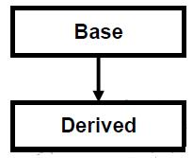
Inheritance - single
when a single derived class is created from a single base class then the inheritance is called as single inheritance.

Slide 33
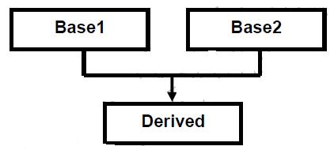
Inheritance - Multiple
when a derived class is created from more than one base class then that inheritance is called as multiple inheritance. But multiple inheritance is not supported by java using classes and can be done using interfaces – The diamond ambiguity.

Slide 34
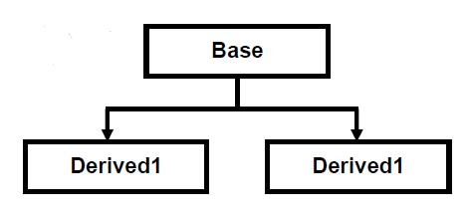
Inheritance - Hierarchical
when more than one derived class are created from a single base class, then that inheritance is called as hierarchical inheritance.

Slide 35
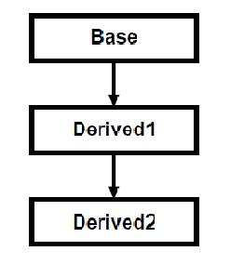
Inheritance - Multi Level
when a derived class is created from another derived class, then that inheritance is called as multi level inheritance.

Slide 36
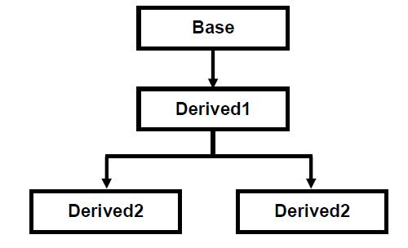
Inheritance - Hybrid
Any combination of single, hierarchical and multi level inheritances is called as hybrid inheritance.

Slide 37
Inheritance in java - syntax
class Subclass-name extends Superclass-name
{
//methods and fields
}

Slide 38
Inheritance in java - example
class Employee
{
float salary=40000;
}
class Programmer extends Employee
{
int bonus=10000;
public static void main(String args[])
{
Programmer p=new Programmer();
System.out.println("Programmer salary is:"+p.salary);
System.out.println("Bonus of Programmer is:"+p.bonus);
}
}

Slide 39
interface
A contract exposed by class to be implemented by outside world
Methods form the object's interface with the outside world.
They help realize true data abstraction.

Slide 40
polymorphism
The ability of an object to behave differently under different circumstances.
This is realized through inheritance.
Types – broad classification
Static/compile time polymorphism(Method overloading)
Dynamic/run time polymorphism(Method overriding)

Slide 41
Trivia
Java programming language was originally developed by Sun Microsystems which was initiated by James Gosling and released in 1995 as core component of Sun Microsystems' Java platform (Java 1.0 [J2SE])

Slide 42
Q & a
Real-world objects contain ___ and ___.
A software object's state is stored in ___.
A software object's behavior is exposed through ___.
Hiding internal data from the outside world, and accessing it only through publicly exposed methods is known as data ___.
A blueprint for a software object is called a ___.
A collection of methods with no implementation is called an ___.

Slide 43
#references
http://docs.oracle.com/javase/tutorial/java/concepts/index.html
http://www.tutorialspoint.com/java/index.htm

